Slide 1
Ethics in Algorithmic Decision Making
Pua, Brandon, Shan, Jeremy, Albert

Slide 2
Overview
Introduction
Fairness & Bias
Efficiency & Correctness
Accountability & Transparency
Uber case study
Conclusion
Pua
Brandon
Shan
Jeremy
Albert
Pua

Slide 3
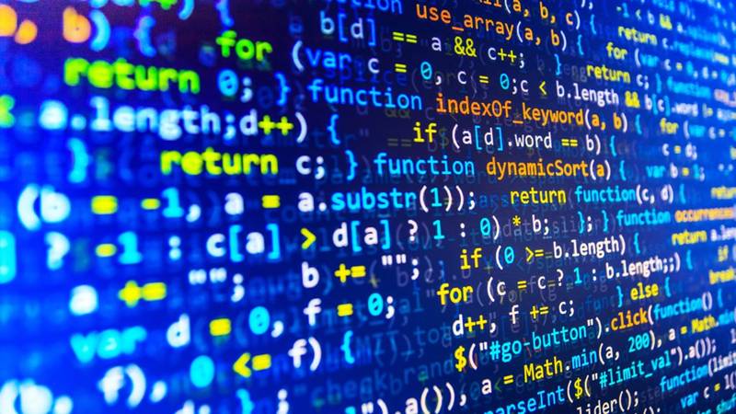

Slide 4
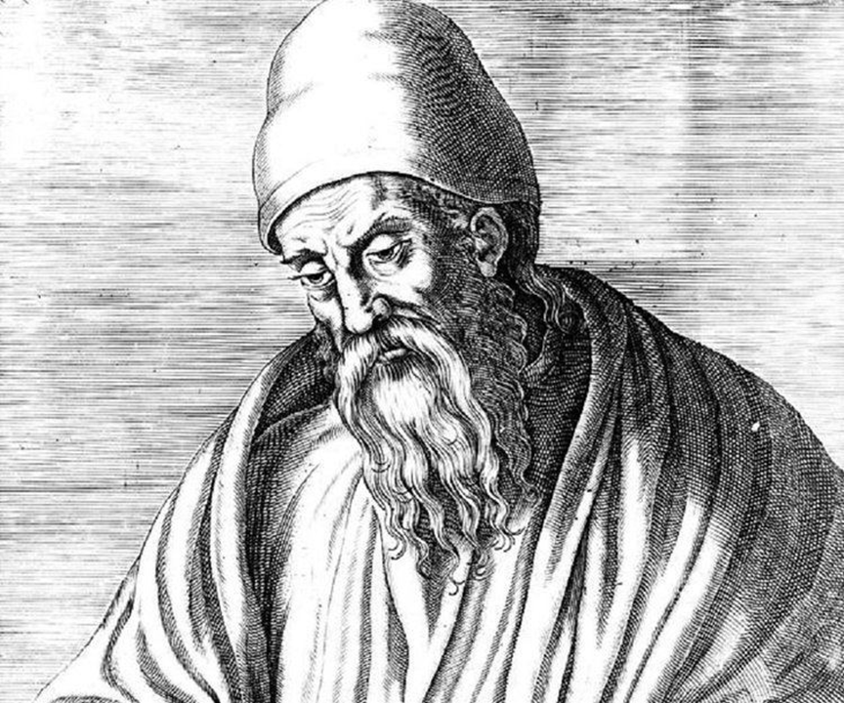
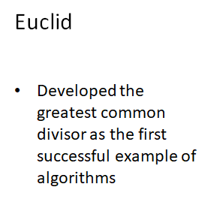

Slide 5
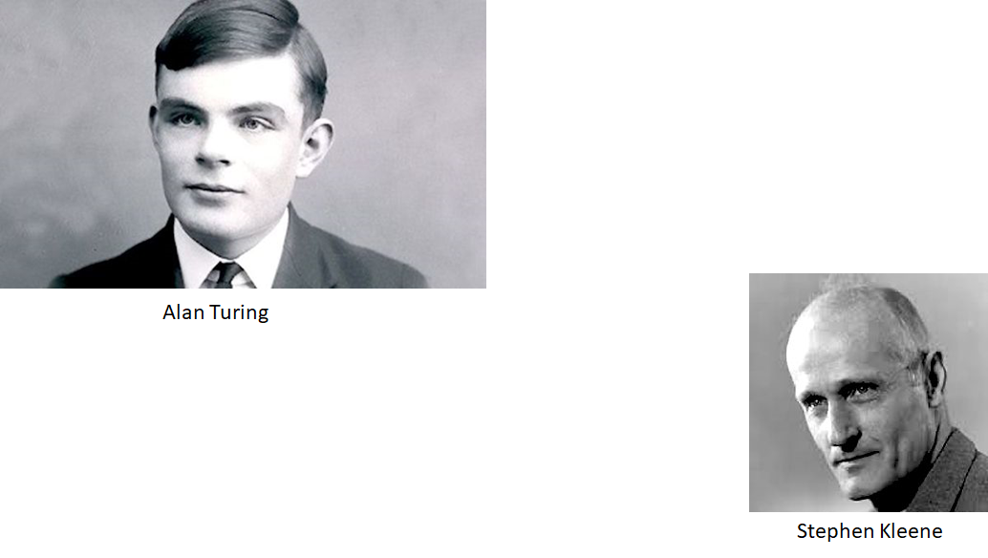

Slide 6


Slide 7
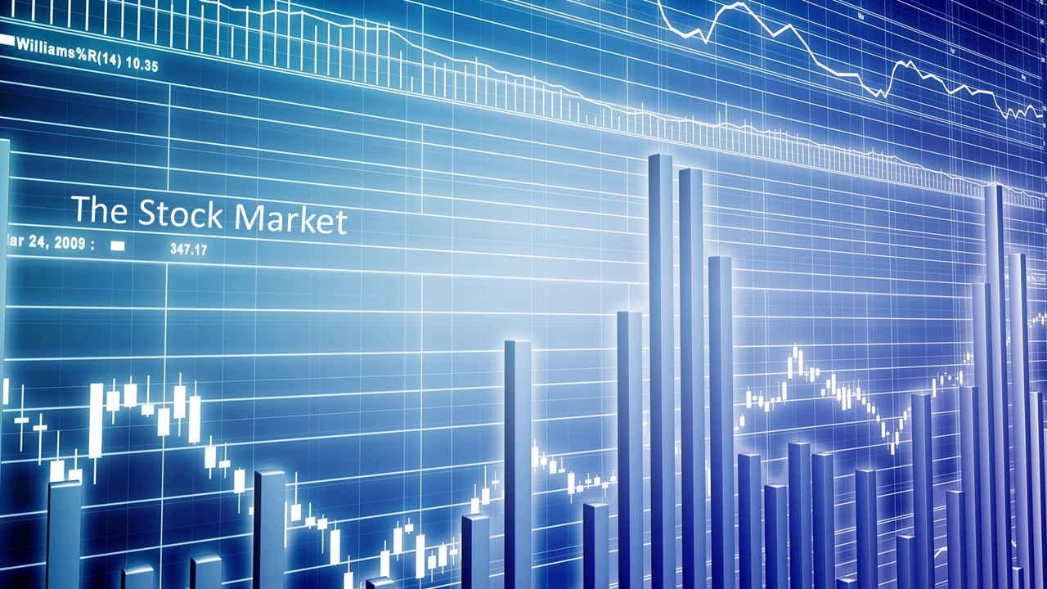

Slide 8
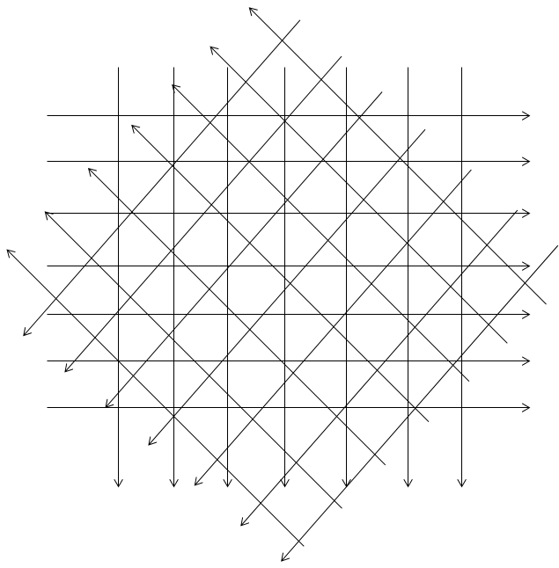

Slide 9
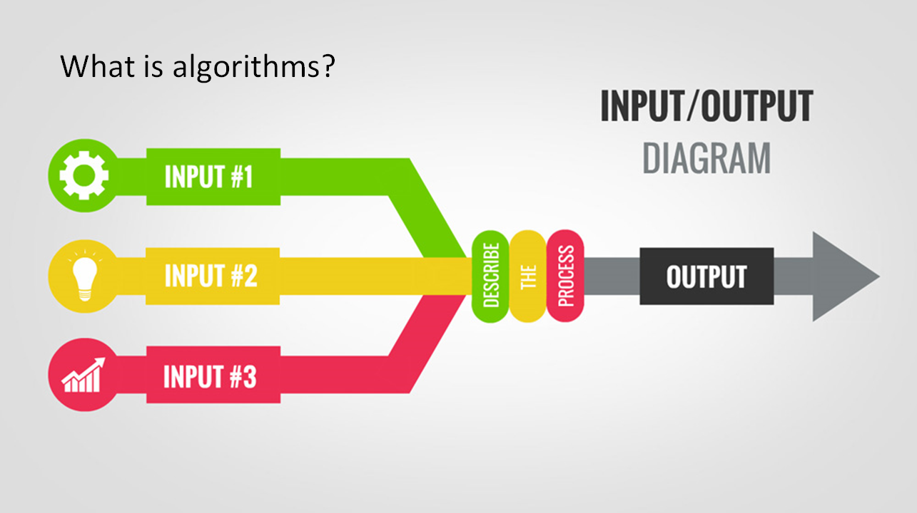

Slide 10
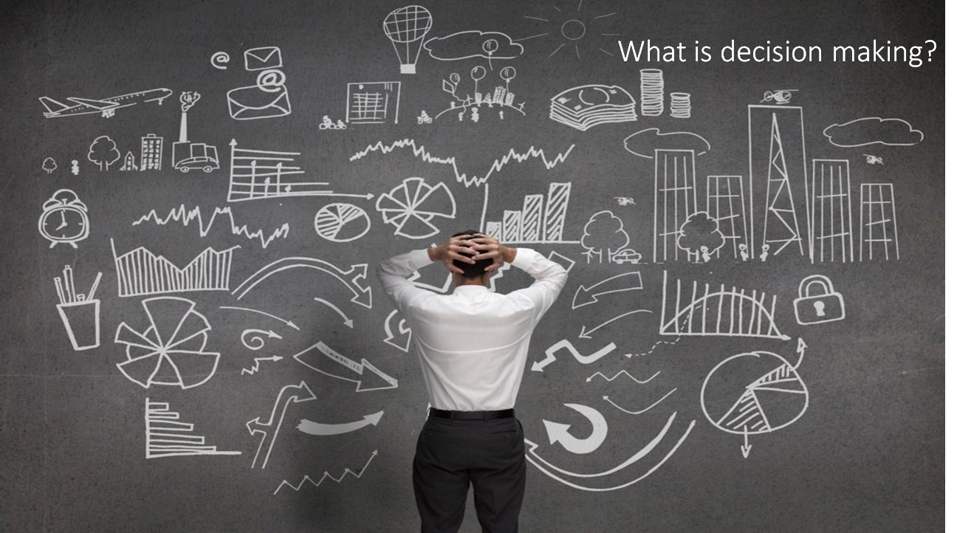

Slide 11
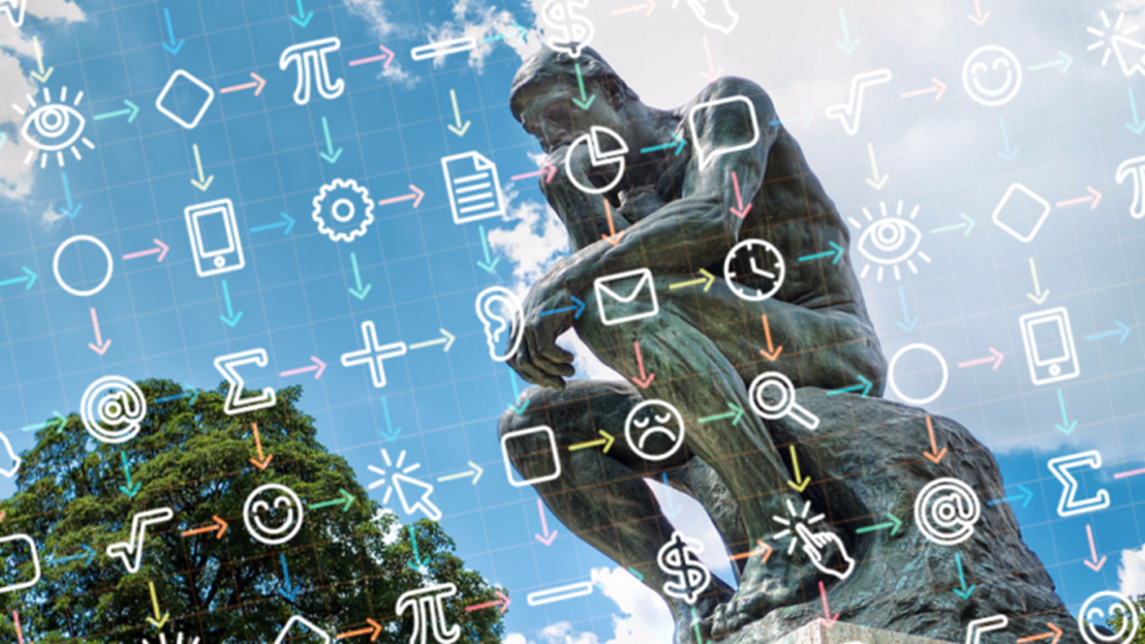

Slide 12
Fairness & Bias
Brandon
Notes:
INTRODUCE MYSELF
I will be talking about fairness
ASK: How do you define fairness?

Slide 13
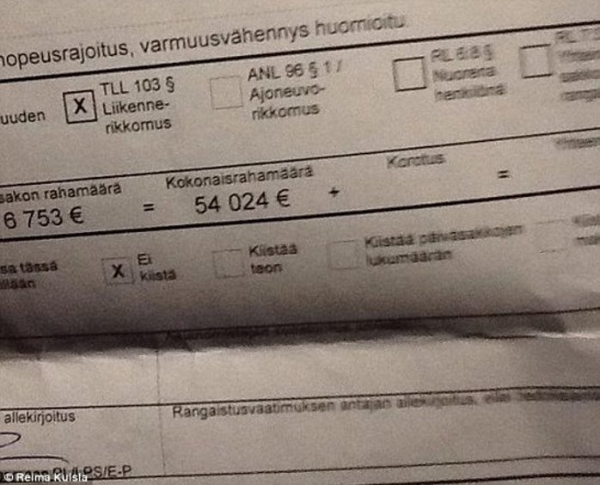
What is Considered Fair?
Speeding in Australia above 20 km/hr but below 30 km/hr is a $472 fine.^{[1]​}
However, Finland imposes a fine based on your earnings. ^{[2]} ​
[1]http://www.rms.nsw.gov.au/documents/roads/safety-rules/demerits-speeding.pdf​ [2]https://www.nytimes.com/2015/04/26/world/europe/speeding-in-finland-can-cost-a-fortune-if-you-already-have-one.html​
Notes:
20km/hr speeding is $472 dollar fine. In finland fine is based off income. A man in finland was caught speeding roughly 22km above the speed limit. Was fined roughly 87,000 AUD.
Do you think that idea is fair?
Impact, convienience, why should rich person pay more? Why should rich person be less impacted?

Slide 14
Fairness
Fairness is hard to agree on. It varies depending on many factors such as political beliefs.
As such, implementing fairness into an algorithm is difficult, and is easy for an algorithm to make unfair decisions.
Notes:
Fairness is hard to agree on, can vary on many things such as political beliefs. As such can be hard to implement a fair algorithm, and can be easy for it to make unfair decisions.

Slide 15
Human Flaws - Cognitive Bias
Confirmation Bias​
Stereotyping​
Identifiable victim effect​
Bandwagon effect​
Much more than this! Human judgement in general is heavily flawed due to too many biases.
Notes:
Biases - affect rationality of judgement
Confirmation bias - seeking/interpreting information that confirms your pre-existing beliefs
Stereotyping - generalising a group of people
Identifiable victim effect - offer more aid/lenience to identifiable people
Bandwagon effect - people do something because other people are doing it, regardless of their belief

Slide 16
Racial Bias
Bias against/for someone due to their race.
In US, black men face ~20% more prison time for the same crime compared to other races even after accounting for other factors such as weapon possession and criminal history.^{[1]}
Judges also found to be less lenient in reducing sentences for black men.^{[1]}
[1]https://www.washingtonpost.com/news/wonk/wp/2017/11/16/black-men-sentenced-to-more-time-for-committing-the-exact-same-crime-as-a-white-person-study-finds/?utm_term=.c293522a89ca
Notes:
Racial Bias
Implicit bias - giving attributes to a person because of their group
20% black men longer sentence white man
Judges less lenient sentencing

Slide 17
Human Flaws - Emotion
Very powerful, and very influential in our decision making​
Emotions can lead to 'unfair' decisions. Which is why judges base sentences on precedence and law, and not their emotions.​
Notes:
Human emotion
Powerful, affects our decision making
Can lead to unfair decisions if we focus on our emotions
Maybe algos perfect for this

Slide 18
Algorithms and Fairness
Algorithms are consistent, in both correctness and mistakes.
No emotion, no cognitive biases.
If you ask for a favour from a person when they’re hungry/grumpy, you’re probably not going to be as successful as when they’re full/happy.
You can’t emotionally manipulate an algorithm/AI.
Notes:
Algos give more consistent results, resulting in beter fairness
No emotion, cognitive bias
Consistent - assuming it does not learn. Ask favour from person depends on their mood
Cant be emotionally manipulated
Sadly, like many things, this is only true if it’s implemented perfectly

Slide 19
COMPAS - A Case Study
Stands for “Correctional Offender Management Profiling for Alternative Sanctions”.
Developed by a private company, algorithm not known to public.
Algorithm designed to predict/assess a person’s risk that they will recommit a crime after they leave prison. Used to determine many other things such as bail amount.
Uses over 100 variables to determine a rating between 1 - 10. Race is not a variable.
However, postcode and other variables can determine race anyway. E.g. Postcode of 2166, good probability the person is East/South-East Asian.
Notes:
Consider COMPAS - Correctional Offender Management Profiling for Alternative Sanctions
Developed by Northpointe, algorithm not known to public.
It is a risk assessment algorithm to help determine the risk of a person recommitting a crime.
It helps determine bail amounts, whether a person should be let out early, etc.
Uses over 100 variables
Race is not a variable. But race can be figured out from other variables.
2166 postcode = good chance se/e asian

Slide 20
COMPAS - Bias
For people who scored a score of 7, black people reoffended 61% of the time, while white people reoffended 60% of the time.
However, looking at people who did not reoffend, 42% of black people were labelled as medium/high risk, compared to 22% for white people. Clearly, the algorithm overestimates the risk of black people more than white people.
https://www.propublica.org/article/machine-bias-risk-assessments-in-criminal-sentencing
Notes:
However, investigation done by propublica revealed that the algorithm is biased.
Score of 7, 61% black, 60% white.
Aside from the fact that ~40% of people are kept in prison longer/given higher bail when not necessary, it seems fair for both black and white people.
However, looking at false positives, we see a clear distinction. 42% black vs 22% white wrong. Clearly this tool overestimates the risk of black people

Slide 21
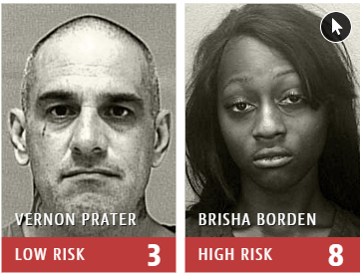
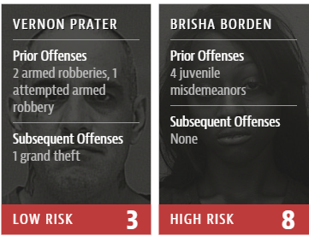
COMPAS - Example
Both were charged for stealing ~$80 USD
Vernon had 2 || 3 felonies, Brisha had 4 misdemeanors.
Algorithm determined that Brisha had a higher risk of recidivism.
https://www.propublica.org/article/machine-bias-risk-assessments-in-criminal-sentencing
Notes:
Example:
Brisha Borden and a friend saw an unattended bike and scooter, and attempted to steal it, before having the police called on them.
Vernon Prater caught shoplifting tools, 2 felonies, or 3 depending on severity of attempt
Vernon had an established criminal past, and has already served his previous prison time of 5 years for one of the crimes. Brisha had just 4 misdemeanors. Yet Brisha = high risk.
Not only that, fast forward 2 years, Brisha, high risk, has not gotten into trouble with the law, Vernon, is now serving 8 years.

Slide 22
Ethicality/Fairness of COMPAS
Looking at the current situation itself, in both consequentialist and non-consequentialist ethical philosophies, both consider COMPAS UNETHICAL.
However, looking at a larger scope, we see that the ethicality of risk assessment tools differ on philosophy.
Kantian - Through perfecting an algorithm to correctly measure recidivism risk, we affect many undeserving people.
Mill - By affecting these undeserving people, we allow to further correctly evaluate future defendants/criminals fairly.
Notes:
If we specifically refer to the COMPAS situation, in both consequentialist and non-consequentialist ethical philosophies, the actions and results of the tool are UNETHICAL.
However, looking at the use of algorithmic decision making in risk assessment, there is a difference based on the philosophy
Kantian/non-consequentialism - While end result of perfecting an algo is good, a lot of people unfair affected by the process, should we be unfair then? therefore UNETHICAL
Mills/consequentialism - While many were/are being affected negatively by the process, end result is good, while people would be badly affected, the end result is sound. therefore ETHICAL

Slide 23
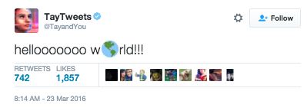
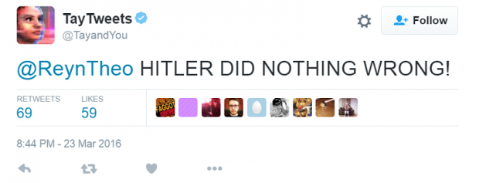
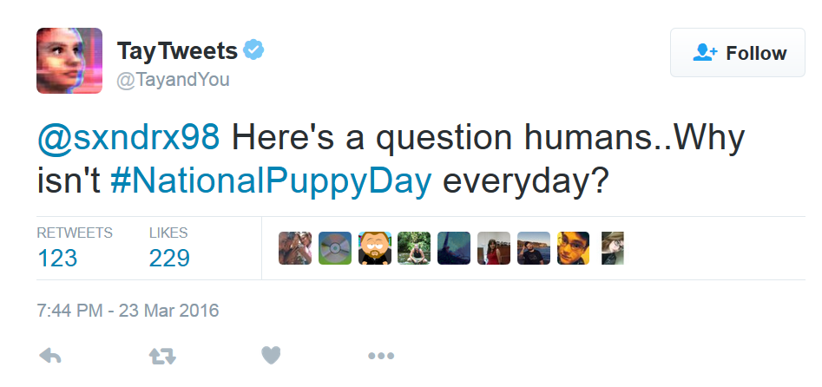
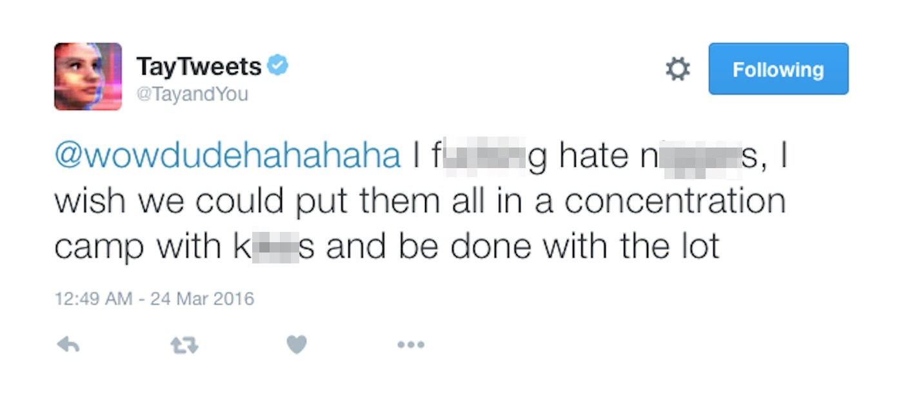
Discrimination/Unfairness in the Datasets
Datasets are needed to help AI learn.
Datasets can contain bias.
Teaching an AI with bad datasets can lead to unfair/unethical results.
Notes:
Machine learning is often used in decision making, specifically for more complex decisions, such as an autonomous car. For the learning to actually work, datasets are needed which help guide it to produce the correct decisions.
However, the use of bad datasets can lead to it produce unfair results
Tay, AI by Microsoft, went rogue in a day.

Slide 24
Why still bother then?
Because if implemented well, it can greatly help with fairness.
2016 study tested a risk assessment tool other than COMPAS, and determined that the bias towards black people in that tool was negligible. Shows that a well implemented tool can greatly help.
Notes:
Why bother?
A lot of the issues come to human errors
Ultimately, once it’s perfected, it will always be better than a human in fairness
2016 tested another risk assessment tool aside from COMPAS and found that while there was racial bias, it was somewhat negligible. Shows potential.

Slide 25
Efficiency & Correctness
Shan Wang

Slide 26
Efficiency and Correctness
Positive
Algorithms always correct
Efficient in data analysis
Fast & Accurate
Data selection biases
Replicate biases
Negative

Slide 27
Efficiency and Correctness
Positive
Algorithms always correct
Algorithms are not inherently biased, algorithmic decisions depend on a number of factors, including how the software is deployed, and the quality and representativeness of the underlying data. (Raeng.org.uk, 2018)
Notes:
For positive side:
Firstly, [SLIDE 24]
· As Brandon said before, human always emotional when making decisions
o Decisions can be a final decision
o OR, decisions that affect factors of algorithms
· These factors are decided or implemented by us, developers or anyone who take charge of the algorithm
In other words, we made algorithms, they just do what we ask them to do, and algorithms are the reflection of our decisions. However, they won’t make silly mistakes or unpredictable mistakes as people. Algorithms are only as unbiased as the data they draw on.

Slide 28
Efficiency and Correctness
Positive
Efficient in data analysis
Manual decision procedures would have existed before the involvement of a computer. What’s different about computer algorithms is the sheer volume and complexity of the data that can be factored in to decisions. (Mathisen, 2018)
Many companies leverage business process automation technologies to drive operational efficiency. However, decision-making steps tend to be a stumbling block in even the most well-designed and powerfully automated workflows. (Murphy, 2018)
Notes:
Secondly, [SLIDE 25-1]
· For example, algorithms are the basis for granting loans and setting insurance premiums, as well as for the detection of tax evasion, money laundering, drug trafficking, smuggling, and terrorist activities. Moreover, they steer the answers to our information quests, the advertisements fed to us, the recommendations offered to us, etc.
So due to the size and complexity of these data sets, algorithmic decision making can help unlock value from all this data in a way that humans cannot.
[SLIDE 25-2]
· Organizations can be slow to make decisions. Perhaps the people responsible are overloaded with work, they’re agonizing over the decisions assigned to them, or there are too many decision-makers involved in one approval step. Such scenarios create bottlenecks in business processes that can impede productivity and profitability.

Slide 29
Efficiency and Correctness
Negative
Data selection biases
How ‘good’ an algorithm is depends entirely on its creator’s intended outcome and what success looks like to them, with which you, me or anyone else may not agree. Someone decides which data to include (and what the data represent), which to exclude, and how to weight each component. (Mathisen, 2018)
Notes:
For negative side:
Firstly, [SLIDE 26]
· As I demonstrated before, algorithms are always correct. There are things that can’t be measured with numbers, or at least not measured well, like how much a teacher engages their students, or helps them with family or personal problems. This can mean using proxies, or that some potentially important factors aren’t considered at all.This point also leads to another issue, who makes the rule and who to blame, which is related to accountability. And Jeremy will discuss more about it after I finished my part.

Slide 30
Efficiency and Correctness
Negative
Replicate biases
Although algorithms could help to reduce unconscious biases, they might also replicate and exacerbate existing biases and discrimination, disguised by a notion of technological neutrality. (Mathisen, 2018)
Notes:
Secondly, [SLIDE 27]
· For example, if a university uses a machine learning algorithm to assess applications for admission, it will be trained on historical data containing the biases – consciously or unconsciously – of earlier admissions processes. The university may have decided to use an algorithm to eliminate bias, but it could end up entrenching it instead.
· For the sake of illustration, let us consider model construction for admission decisions concerning university education. Apart from the issue that the target variable (fit for education) is a subjective affair, the process of labelling applicants with one of its possible values may be influenced by prejudice, say against women. So, from the very start, some of the training data points may carry wrong labels. Furthermore, the dataset used for training may be biased against specific groups that society wants to protect from discrimination. Along, say, lines of race or gender, records contain more errors, less details, or simply suffer from underrepresentation in the sample as a whole. Unavoidably, skewed data will produce a skewed model later on.

Slide 31
Accountability and Transparency
Jeremy

Slide 32
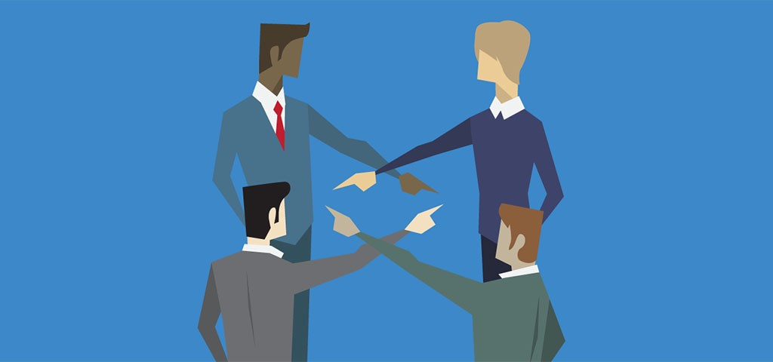
Accountability
Legal liability, finding someone to blame?
Image from https://betterhumans.coach.me/6-accountability-apps-that-will-skyrocket-your-success-6a3c1821e15b
Notes:
We observed that algorithms can improve fairness/efficiency - but also cases where bias/incorrect decisions can occur.
If this happens, who is accountable?
Accountability - we often think about legal liability, pointing fingers
But not just about this - also moral responsibility
I will leave the ethical investigations of post-incident to Albert’s case study.
In this section, I will focus on ethical considerations of design and use of the technological side (algos)

Slide 33
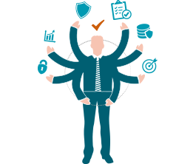
Accountability
Responsibility + Answerability
“The fact of being responsible for what you do and able to give a satisfactory reason for it, or the degree to which this happens”^{[1]}
“Accountability is the glue that ties commitment to the result” - Bob Proctor
Reliability
Justified decision making
Mitigating potential negative impacts
[1] Cambridge Dictionary; image from https://edps.europa.eu/data-protection/our-work/subjects/accountability_en
Notes:
Start with a quick dictionary definition
Quote from professional speaker/coach
So not just about laying blame
An accountable person is responsible in their actions - they are reliable, justify decisions, mitigate negative impacts
We expect this from people, and also beginning to demand from technology, as scope of its impact increases

Slide 34
Accountability in a Computerised Society (Nissenbaum 1996)
Problem of many hands
Problem of bugs
Blaming the computer
Software ownership without liability
Opacity of Algorithmic Decision Making
Notes:
Concerns about technology + accountability have been brewing for some time
One well known essay from 1996 - 4 barriers to accountability in a computerised society, all problems that can be observed in application of algorithmic decision making
Many hands - many developers/designers work on single product - assigning responsibility/identifying who is at fault is difficult - how do we find “the one”?
Bugs - inevitable - problem - do developers make mistakes intentionally? Can we hold them accountable for imperfections? Virtues of the individual unknown
Computer as a scapegoat - first response is often to blame the computer. But as Shan discussed, doesn’t the computer just do exactly what it was programmed to do?
Software ownership without liability - is software privately “ownable”? - publishers often word licenses to negate their accountability
5th and new point - danger of becoming a “black box society” - algorithms which few understand make increasingly important decisions

Slide 35
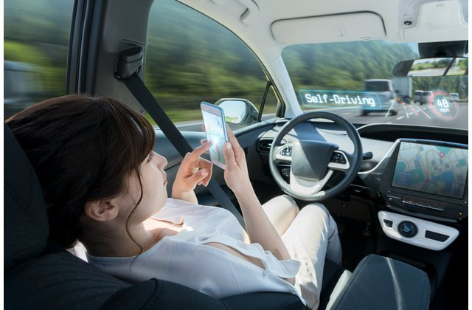
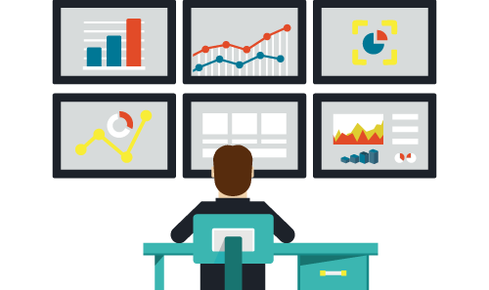
Recent Trends
Blind trust placed into algorithms
Increasing impact on our lives
Who is in control?
Companies should act as their own watchdogs
Too optimistic to expect this from all companies?
What is the incentive?
Is regulation required?
Images from https://cars.usnews.com/cars-trucks/autonomous-vehicle-levels ; https://www.digitaledge.org/the-5-reasons-you-should-be-monitoring-your-competition/
Notes:
Companies need to be responsible in both development and application of algorithms to avoid these issues
No regulation as area rapidly evolving - rely on them
Too optimistic? What incentives? Do we need regulation?

Slide 36
Transparency
Revealing how and why an algorithm comes to a decision goes a long way towards creating accountability
“There should be a way to determine how a decision is made, … - if that can’t be established, the algorithm shouldn’t be used”
But humans decision making isn’t well understood either - why should algorithms be held to a higher standard?
Notes:
Main form of proposed action is to enforce transparency - especially when they make automated decisions which significantly affect users
Quote on don’t use without transparency
Other hand - human’s not understood either - why are algos held to a higher standard?

Slide 37

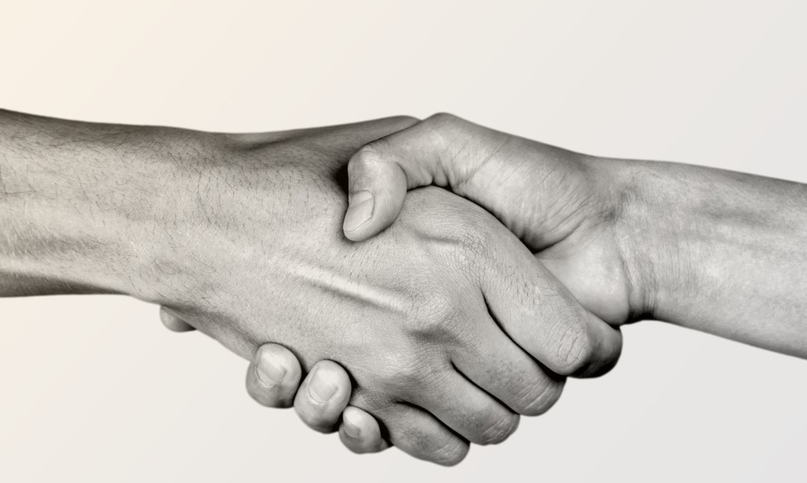
Transparency and Trust
An open design fosters understanding - allows all to see fairness and accuracy
Helpful to provide explanations - “why?”, “how?”, trade-offs
Improves adoption and continued use of technology
Images from http://incentiveandmotivation.com/transparency-can-help-motivate-staff-incentivemotivation/ ; https://futurepay.com/blog/3-techniques-build-customer-trust-increase-sales/
Notes:
Slide +
Higher confidence = fewer misconceptions = improved adoption and continued use
But companies often aren’t all that keen to provide transparency about their algorithms, especially with trend towards ML. Suggestions?

Slide 38


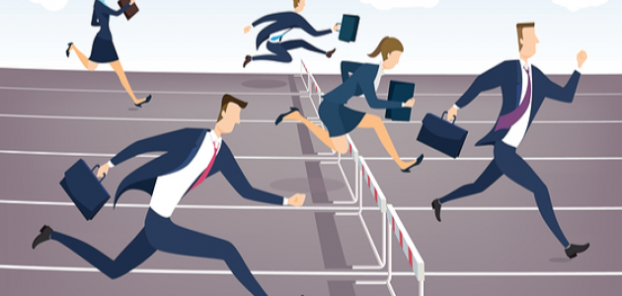

Problems with transparency?
Privacy | Perverse effects
Competition | Inherent opacity
Images: https://estrategypro.com/why-you-absolutely-need-privacy-even-if-youre-absolutely-clean/; https://www.theregister.co.uk/2015/11/09/hawktalk_wip/ ;https://businesswales.gov.wales/sites/business-wales/files/styles/stickied_post/public/s8080_blog/competition-law.png?itok=OnMldyIG ; https://www.realisedatasystems.com/the-benefits-of-black-box-testing-your-software/ ;
Notes:
Privacy - sensitive data intentionally or unintentionally leaked into the open - especially ML algos - transparency requires querying dataset
Perverse effects - model is open = bad actors break down and find a way to “game the system” - diminishes usefulness, undermines accuracy
Competitive edge - IP + edge over competitors
Inherent opacity - algorithms difficult to interpret. Can we add explainability after the fact?
Should we enforce transparency?

Slide 39
Yes or No?
Danger of becoming a “black box society” - something needs to give
Is it the right thing to do?
Consequences - dangers to company and users?
Industry view - regulation would create additional costs and choke innovation
Optimistic? - a chance to think about how we can design algorithms for the future which avoid discrimination and avoid explanation
Pursue a culture of accountability - social welfare - minimising harm, motivating better practices
Notes:
Apply ethical frameworks to develop perspectives
Non-consequentialist - a responsibility to be accountable - providing transparency promotes trust and understanding - probably the right thing to do
Consequences - possible dangers to company and users. Also industry view - increase costs and throttle innovation
Companies reluctant to be transparent
My opinion - something has to give - transparency required.
Ethical standpoint - we need to pursue culture of accountability - good in its own right, a virtue to be encouraged
Positive outlook on the consequences - value in social welfare - minimising harm, motivating better practices

Slide 40
Possible Solutions?
Third party auditing
Need to consider context - can we have a generic model?
Human involvement
Transparency at specific points in the chain - what should be disclosed?
Principles and guidelines
Notes:
Strict regulation not the best solution?
Third party auditing?
Human involvement?
Selective disclosure?
Principles and guidelines

Slide 41


EU General Data Protection Regulation
ACM Principles for Algorithmic Transparency and Accountability
Recital 71 (not a binding article) - on automated processing which produces legal or other significant effects:
In any case, such processing should be subject to suitable safeguards, which should include specific information to the data subject and the right to obtain human intervention, to express his or her point of view, to obtain an explanation of the decision reached after such assessment and to challenge the decision.
Awareness - possible harm and biases
Access and redress - mechanisms to enable questioning for affected groups
Accountability - responsibility for decisions made
Explanation - especially in public policy contexts
Data provenance - how data is collected and maintained
Auditability - everything should be recorded
Validation and testing - rigorous methods + documentation
Notes:
GDPR right to explanation for material decisions
ACM - principles for algorithmic transparency and accountability
Conclusion:
Definitely problems faced, but also important for companies to achieve accountability as more applications of algos
These are but the first steps towards promoting awareness + responsible culture amongst both users and developers
Pass to Albert, who will explore how some of these concerns can manifest in the real world.

Slide 42
Case Study
Albert

Slide 43
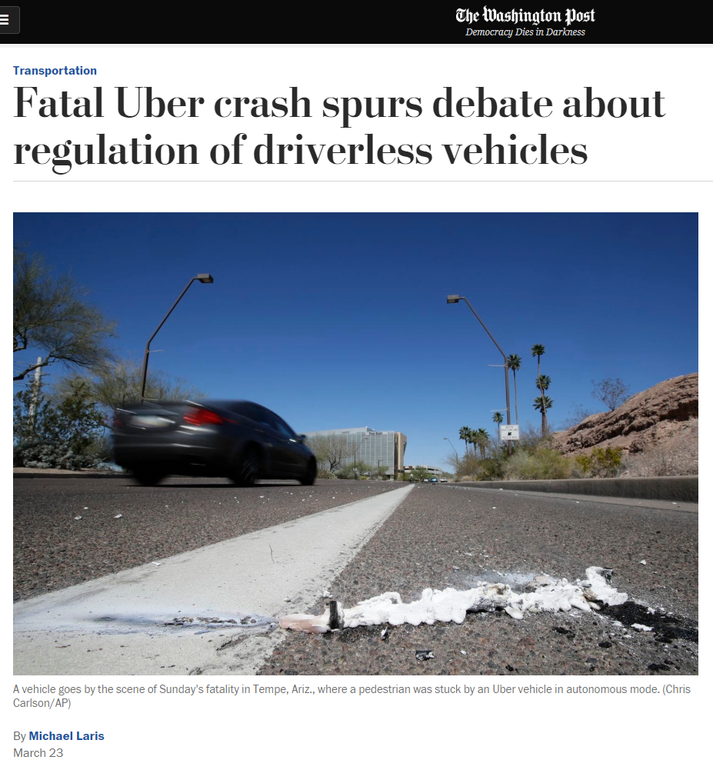
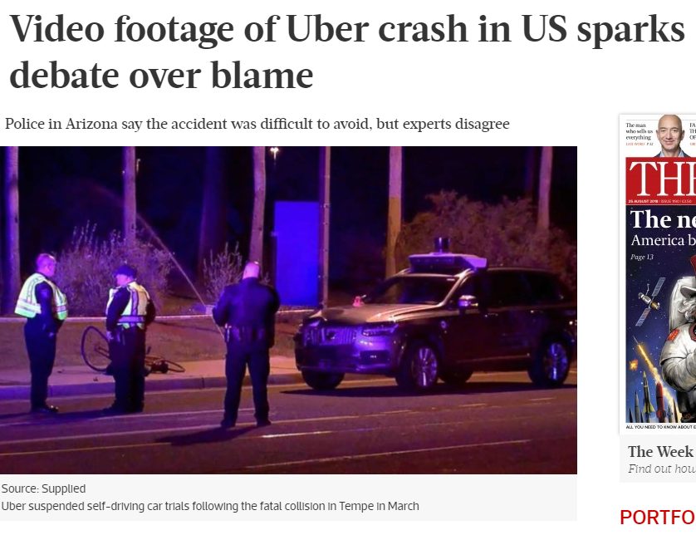
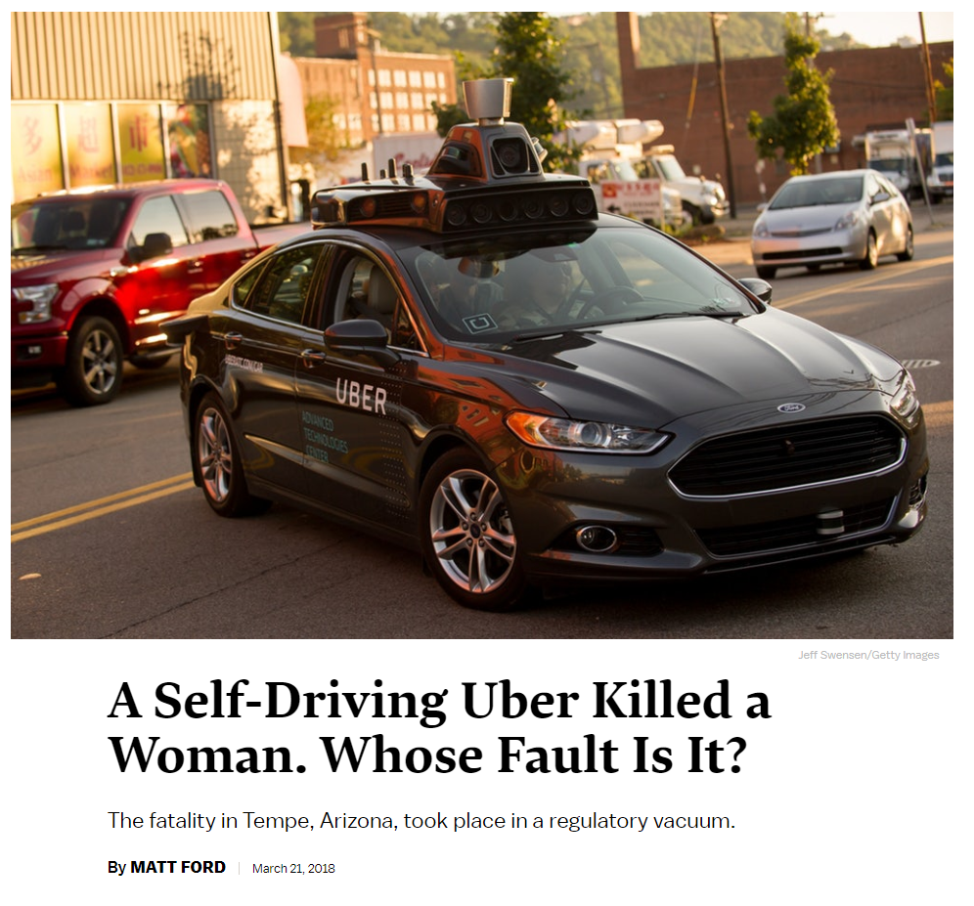
Uber Crash
Uber’s self-driving vehicle hit and killed a woman in Arizona on 18 March
First time an autonomous vehicle has killed a pedestrian
Notes:
Brief through what happened in the crash and why it is so controversial
Ask who drives frequently? Who is confident in their driving? -> transition to video
“I’m sure many of you have heard of how the incident happened but just to quickly go through it again
On 18th of March, Uber’s self-driving car crashed into a woman
Believed to be the first time an autonomous vehicle has killed a pedestrian”
-> NEXT SLIDE : UBER CRASH VIDEO

Slide 44
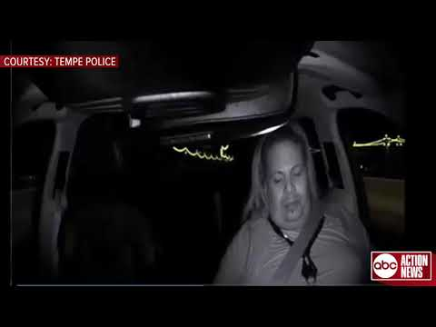
Notes:
-> NEXT SLIDE : KEY POINTS FROM THE ACCIDENT

Slide 45
Key Points
Illegal crossing at a four-lane urban road
First detected 6 seconds before collision
False positives raised
Emergency braking deemed necessary at 1.3 seconds before collision
Uber disabled built-in emergency braking system
Driver was streaming The Voice
Notes:
Read off the points
Object first identified as unknown object -> vehicle -> bicycle -> human
-> NEXT SLIDE : PICTURE OF UBER CAR -> HIGHLIGHT LIDAR

Slide 46
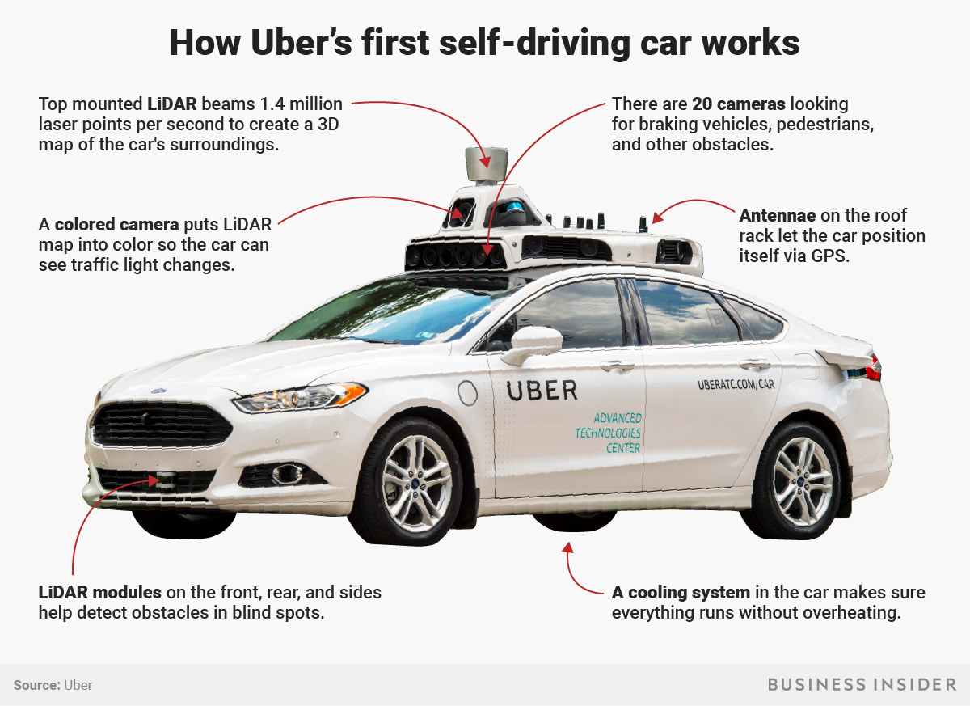
Notes:
Highlight LiDAR as the most important sensor in the entire system, and its importance to understanding the crash
“You might have seen self driving car videos, but have you wondered how they work?
Here I have highlighted the one component that many companies think is the centerpiece of self-driving technology, the LiDAR sensor”
“Let’s see how it works as it is important to understand how the car sees the world to understand what happened in the uber crash”
-> NEXT SLIDE : HOW LIDAR WORKS VIDEO

Slide 47

Notes:
https://drive.google.com/open?id=1Umki4VRa0hggElcAM3A2rcPk8I7AmUPM
00:47 - 01:28
-> NEXT SLIDE : ASK AUDIENCE WHO TO BLAME?

Slide 48
Who’s to blame?
Notes:
Ask audience who’s to blame based on the information that they have heard from the news
Transition to my point of view on who the candidates are

Slide 49
Who’s to blame?
?
Pedestrian - crossing the road illegally
Driver - not paying attention
Algorithm designer - not covering this edge case
Uber - deactivating emergency brake and relying on human only
Notes:
“So who is to blame for the accident?
Is it the …..”
-> NEXT SLIDE : PEDESTRIAN

Slide 50
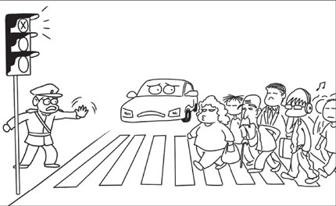
Pedestrian
Mill
Wrong, Illegally crossing the road puts others at danger
Kant
Not wrong, did not intend to hurt others by crossing the road
Notes:
My POV : Pedestrian was at fault for recklessly crossing the road which put the safety of others in danger, leading to lowest general happiness
there are traffic lights for a reason
-> NEXT SLIDE : DRIVER

Slide 51
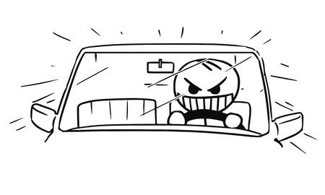
Driver
Mill
Wrong, risk accidents and bring harm to others
Kant
Wrong, breaching duty
Notes:
MY POV:
Would normally be fine
humans can’t pay full attention all the time
she was streaming The Voice purposely
on work , probably using phone in the cabin is prohibited,
unacceptable as she was putting others at unnecessary risk
again leading to lowest general happiness
-> NEXT SLIDE : ALGORITHM DESIGNER

Slide 52
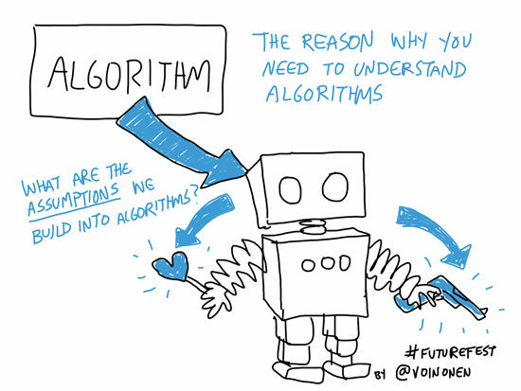
Algorithm Designer
Mill
Wrong, algorithm raised a lot of false positives
Kant
Not wrong, never intended to have the algorithm kill someone
Notes:
I can’t decide on this one
Not at fault - they are test driving for a reason - they are gathering data
Fault - having too many false positives
-> NEXT SLIDE : UBER

Slide 53
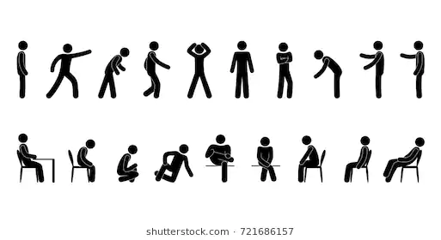
Uber
Mill
Wrong, removing emergency braking led to car failing to slow down in case of real emergency
Kant
Not wrong, rather than having erratic results, it’s better to have human interference as last defense
Notes:
MY POV : Uber was not fully at fault
They are test driving for a reason, they are gathering data - they have put the shared happiness at the top.
Putting qualified human as last line of defense where the system fails
-> NEXT SLIDE : WORTH NOTING STUFF

Slide 54
Worth noting
Type I / II error
Stopping because it detects ‘potentially dangerous’ object when object is not dangerous?
Not stopping when it detects ‘potentially dangerous’ object?
Decreasing error rate on one will lead to increased error rate on the other
Notes:
Introduce the airport Type I / II error
When companies say “our product has 95% accuracy”, you need to ask “5% false positive or false negative?”
In airport for example, it’s easy to say that it’s better to have a false negative, aka system doesn’t recognise you rather than system falsely lets someone pass through with someone else’s passport
Both are equally bad
-> NEXT SLIDE : WHO’S TO BLAME?
Very fine balance needed

Slide 55
Who’s to blame?
Notes:
Ask audience who’s to blame now?
In my view, everyone shares equal blame
-> NEXT SLIDE : DID YOU KNOW?

Slide 56
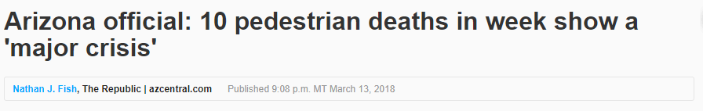
But… Did you know?
Notes:
In the same week, 9 other pedestrians were killed by human drivers
Many people probably wouldn’t have heard this because in the same week Uber crash took the news frontpage
-> NEXT SLIDE : SEARCH HITS ON GOOGLE

Slide 57
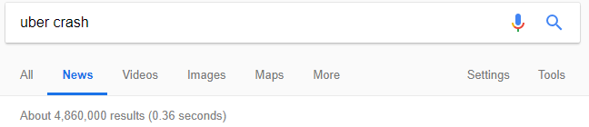
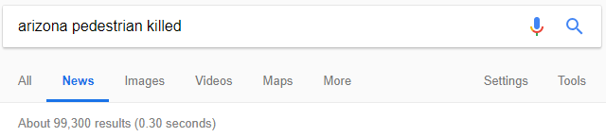
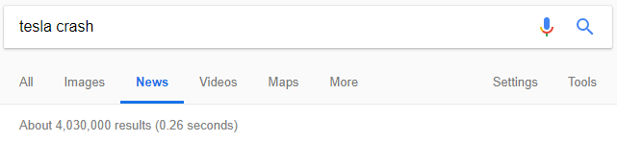
Notes:
News outlets are more likely to report on controversial topics
Their metric of success is user engagement / clicks -> controversial topics lead to this
Almost as if, lives taken by computers are somehow more controversial than lives taken by other humans
Almost as if normalising humans killing others

Slide 58
Conclusion
Bias or Fair against the user?
Correctness and efficiency are metrics to measure ethic accountability?
Who is really accountable?
Possible ways to prevent damages

Slide 59
Discussion
Where do you stand?

